Slide 1
A Unified Push Memory for Generating Hardware Accelerators
Intel Review
Jeff Setter

Slide 2
Background and Motivation

Slide 3
Push memories are used in most accelerators
Memories in accelerators
Capture locality between kernel stages and exploit parallelism
Generate or store streams of data using address information
Pull memory: supplies data to compute units when it receives an address (e.g. a processor cache)
Push memory: generates addresses locally and pushes data to compute units
Data
Pull Mem
Addr
Push Mem
Data
Addr gen
Notes:
Accelerators generally create number of memory units in the design to exploit parallelism and locality to improve performance and energy efficiency.
For most applications the compute hardware works on streams of data, and the memories stream data to this compute or store the data streams that the compute creates.
We call a memory that produces or consumes data streams a push memory, since it pushes the data to the hardware without the hardware asking for it.
One can think of a DMA engine as the hardware needed to convert system DRAM into this type of memory.
Receive address from outside
Passively provide data for the address it received
Actively push data to computation kernel

Slide 4
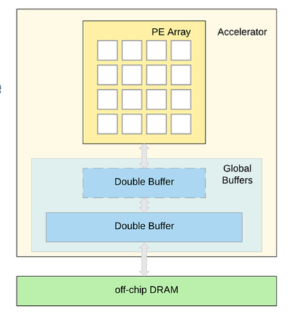
Specific push memory for each application class
For example:
Image processing accelerators use line buffers
DNN accelerators use double buffers
Line Buffered Pipeline
Double Buffered Pipeline
Notes:
The State of the art approach is to create a specific type of memory for each applications class:
For image processing data is generally streamed in raster scan order.
The most efficient push memory in this case is a "line buffer" which stores a few lines of the image
Accelerators have a pipeline of line buffers separating different computational blocks
This arrangement is called a line buffered pipeline
While DNNs also do image processing
They have larger reuse of image data (they generate many output images from the same inputs)
This requires tiling the images and a multi-level memory system
They still use push memories, but the memories are now a different type, they are double buffered memories

Slide 5
Our Solution
Define unified buffers, a universal push memory abstraction, that describe a wide range of accelerator memories.
Create rewrite rules to map abstract unified buffers to more constrained physical implementations of these buffers on FPGAs and CGRA.
Build a Halide-to-Hardware tool-flow that creates hardware accelerators for a wide range of applications using the unified buffer.
Notes:
Address is separate, statically known, easy for optimization
Support arbitrary streams (multi-ported memory)

Slide 6
Unified Buffer Abstraction

Slide 7
Unified Buffer
Push Mem
Data In0
Addr gen
Addr gen
Data Out
Addr gen
Data In1
Notes:
Our unified buffer has a number of input streams that feed it, and supply a number of output streams it generates. It is specified by a small number of parameters. One specifies the logical size of the memory, and then 3 parameters for each stream that specify its characteristics.

Slide 8
Abstraction Parameters
Logical size: total size of the data cube being processed
This is not the memory size, since later we do storage folding
Input stream(s)
Input chunk size: data cube that is needed for the next iteration
Input block size: data cube written each cycle to the chunk
Input access pattern: address sequence for writing blocks
Output stream(s)
Output stencil size: data cube available to read each iteration
Output block size: data cube read each cycle from the stencil
Output access pattern: address sequence for reading blocks

Slide 9
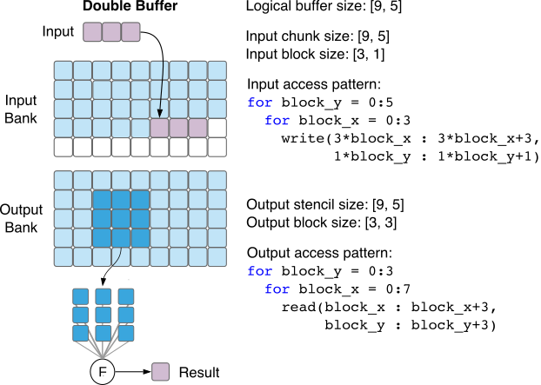
Double buffer as a unified buffer
Input chunk is the same size as the output stencil
The output stencil is very large (45 pixels), so only an output block is read each cycle (9 pixels)
For a double buffer, we access the buffer over multiple cycles

Slide 10
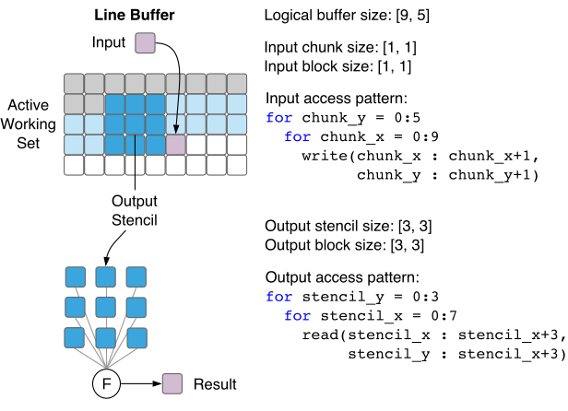
Line buffer as a unified buffer
Input and output blocks are the same size as the chunk/stencil
Since the input is just 1 pixel, then 8 pixels in the new output stencil are reused
For a line buffer, we have overlapping output stencils

Slide 11
Additional flexibilities in unified buffer
Combine both overlapping and multi-cycle execution
Can have multiple input and output streams
Multiple consumers of buffer => multiple output streams
Accumulation of values => multiple input streams
Implementing these buffers in hardware?

Slide 12
Buffer Mapping Rewrite Rules
Notes:
Showing the lake rewrite rule transform the IR from halide application level to hardware

Slide 13
Unified Buffer Mapping
Mapping hardware-agnostic app IR to hardware-aware circuit IR
Halide IR
Loop Nest
Core IR before rewrite
Virtual unified buffer parameters
Core IR after rewrite
A hardware-aware circuit DAG
Unified buffer hardware implementation
Rewrite rules
Notes:
The second step uses a set of rewrite rules which take the abstract unified buffer parameters generated from the application and
recursively break these memories into a set of simpler unified buffers (and some additional logic) until the resulting buffers can be mapped on the hardware created in step one

Slide 14
Rewrite 1: Linearize Address Space
Flatten high dimensional loop nest access into access pattern
Flattened access pattern for 3x3 conv:
Range list: {7, 3}
Stride list: {1, 9}​
Starting addr: {0,1,2, 9,10,11, 18,19,20}
Loop nest expression for output access​:
for itr1: 0->rng[1]
for itr0: 0->rng[0]​
offset = itr0*stride[0] + itr1*stride[1]
addr[0] = start_addr[0] + offset
addr[1] = start_addr[1] + offset ... addr[8] = start_addr[8] + offset
Notes:
We will flatten the high dim loop nest access into a compact access pattern shown in the following form.

Slide 15
Rewrite 2: Memory Bandwidth Reduction Rule
Known access pattern in unified buffer
Optimization opportunity: insert buffers to capture reuse and increase bandwidth
RAM port 0
2D-LB =
Shift regs + Row buffers
RAM port 1
RAM port 8
Notes:
knowing the access pattern for a buffer allows us to sim-
plify and decompose that buffer. We can reduce the required
memory bandwidth if we fetch the same data multiple times
during the access pattern.

Slide 16
Rewrite 3: Hardware-specific Rewrite
Map abstract memory functional model to technology-aware hardware
Different backends: (With different capacity and port number)
CGRA Memory tile
FPGA BRAM
CGRA-specific Rewrites
Chain memory tiles for capacity
Chain memory tiles for output memory bandwidth
Notes:
From the IR with port optimization done

Slide 17
Implementation: Halide to Hardware Compiler

Slide 18
Halide: a data-parallel DSL
Algorithm: description of computation
Schedule: how to perform algorithm (efficiently)
split, reorder, compute_at, store_at, accelerate, unroll
Describes image processing and DNNs
Generates CPU and Hardware (CGRA) implementations

Slide 19
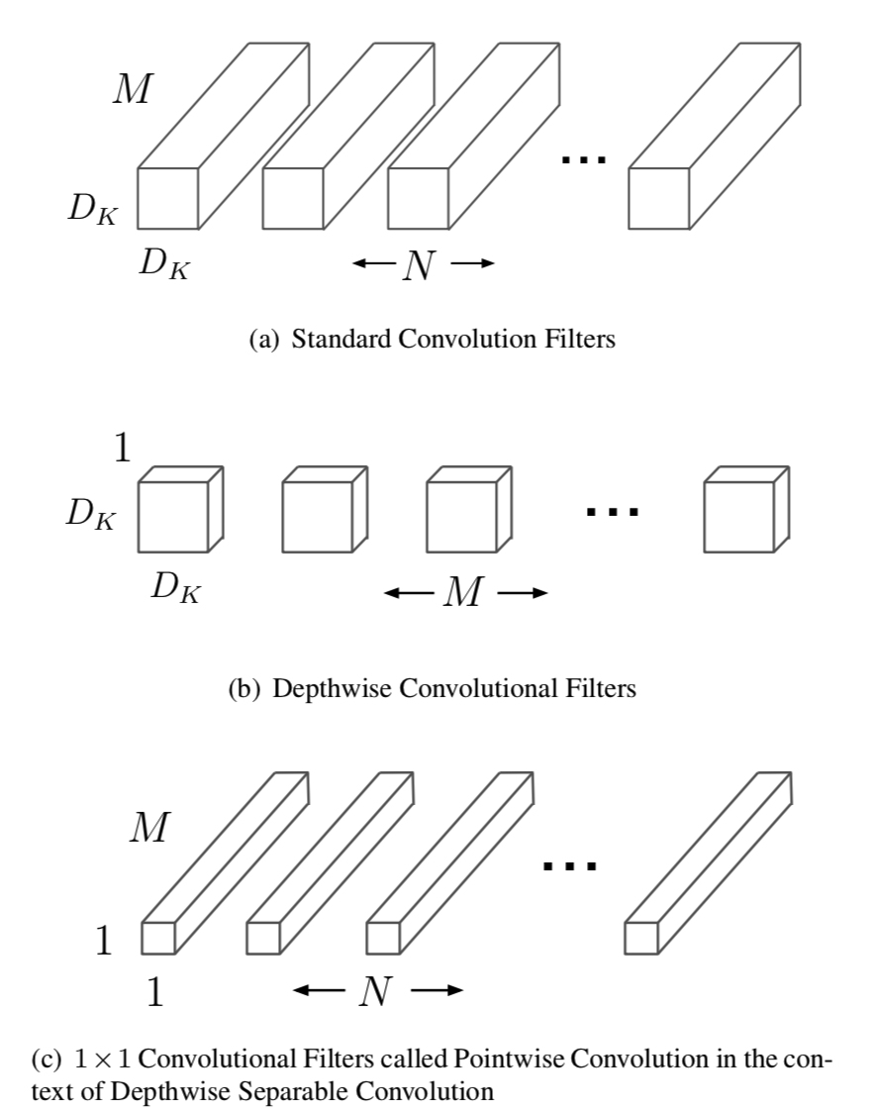
MobileNet Algorithm
// RDom (minX, extentX, minY, extentY); RDom (minC, extentC)
1 RDom r_dw(-1, 3, -1, 3); RDom r_pw(0, 32);
// Depthwise, no accumulation over channel dimension c
2 dw_conv(x, y, c) += input(x + r_dw.x, y + r_dw.y, c)
3 * w1(1 + r_dw.x, 1 + r_dw.y, c);
// Pointwise, accumulation over all input channels
4 pw_conv(x, y, k) += dw_conv(x, y, r_pw.c)
5 * w2(r_pw.c, k);

Slide 20
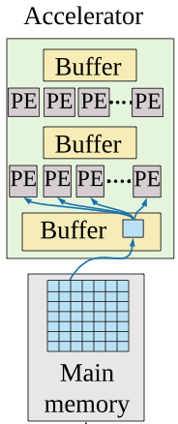
MobileNet Schedule
// Algorithm
1 RDom r_dw(-1,3, -1,3), r_pw(0, 32);
2 dw_conv(x, y, c) += input(x+r_dw.x, y+r_dw.y, c)
3 * w1(1 + r_dw.x, 1 + r_dw.y, c);
4 pw_conv(x, y, k) += dw_conv(x,y, r_pw.c)
5 * w2(r_pw.c, k);
// Schedule
6 pw_conv.split(x, xo, xi, 16)
7 .split(y, yo, yi, 16)
8 .reorder(k, xi, yi, r_pw.c, xo, yo);
9 dw_conv.reorder(x, y, c);
10 dw_conv.compute_at(pw_conv, xi)
11 .store_at(pw_conv, xo)
12 pw_conv.accelerate({input}, xo)
13 dw_conv.unroll(r_dw.x, 3).unroll(r_dw.y, 3);
14 pw_conv.unroll(k, 32);
Tiled
Accelerator with buffers
Parallel compute

Slide 21
MobileNet UBuffers
 | Logical | Output stencil | Output block | Input chunk | Input block
input | 18 x 18 x 32 | 3 x 3 x 1 | 3 x 3 x 1 | 1 x 1 x 1 | 1 x 1 x 1
dw_conv | 16 x 16 x 32 | 16 x 16 x 32 | 1 x 1 x 1 | 16 x 16 x 32 | 1 x 1 x 1
pw_conv | 16 x 16 x 32 | 16 x 16 x 32 | 1 x 1 x 32 | 16 x 16 x 32 | 1 x 1 x 1
allocate output(112, 112, 32)
for pw.yo: 0 -> 7
for pw.xo: 0 -> 7 // store level: input, dw_conv, pw_conv
// compute level: input, pw_conv
allocate input(18, 18, 32)
allocate dw_conv(16, 16, 32)
allocate pw_conv(16, 16, 32)
for r_pw.c: 0 -> 32
for pw.yi: 0 -> 16
for pw.xi: 0 -> 16 // compute level: dw_conv
unrolled for r_dw.y: 0 -> 3
unrolled for r_dw.x: 0 -> 3
dw_conv(pw.xi, pw.yi, r_pw.c) +=
input(pw.xi + r_dw.x, pw.yi + r_dw.y, r_pw.c) *
w1(r_dw.x, r_dw.y, r_pw.c)
unrolled for pw.k: 0 -> 32
pw_conv(pw.xi, pw.yi, pw.k) +=
dw_conv(pw.xi, pw.yi, r_pw.c) *
w2(r_pw.c, pw.k)
Three Unified Buffers

Slide 22
MobileNet UBuffers
 | Logical | Output stencil | Output block | Input chunk | Input block
input | 18 x 18 x 32 | 3 x 3 x 1 | 3 x 3 x 1 | 1 x 1 x 1 | 1 x 1 x 1
dw_conv | 16 x 16 x 32 | 16 x 16 x 32 | 1 x 1 x 1 | 16 x 16 x 32 | 1 x 1 x 1
pw_conv | 16 x 16 x 32 | 16 x 16 x 32 | 1 x 1 x 32 | 16 x 16 x 32 | 1 x 1 x 1
allocate output(112, 112, 32)
for pw.yo: 0 -> 7
for pw.xo: 0 -> 7 // store level: input, dw_conv, pw_conv
// compute level: input, pw_conv
allocate input(18, 18, 32)
allocate dw_conv(16, 16, 32)
allocate pw_conv(16, 16, 32)
for r_pw.c: 0 -> 32
for pw.yi: 0 -> 16
for pw.xi: 0 -> 16 // compute level: dw_conv
unrolled for r_dw.y: 0 -> 3
unrolled for r_dw.x: 0 -> 3
dw_conv(pw.xi, pw.yi, r_pw.c) +=
input(pw.xi + r_dw.x, pw.yi + r_dw.y, r_pw.c) *
w1(r_dw.x, r_dw.y, r_pw.c)
unrolled for pw.k: 0 -> 32
pw_conv(pw.xi, pw.yi, pw.k) +=
dw_conv(pw.xi, pw.yi, r_pw.c) *
w2(r_pw.c, pw.k)

Slide 23
Methodology and Experiment result

Slide 24
Two Reconfigurable Hardware Implementation
SoC with custom unified buffer
Platform: SoC with CGRA + Arm M3
SoC memory hierarchy:
128 memory tiles: 512 x 16 bit SRAM
Global buffer: 32 128-KB SRAM banks
Memory tile has hardware unified buffer implementation
Frequency: 400 MHz
Technology: TSMC 16nm
FPGA
Platform: Xilinx ZCU 102
Toolchain: Vivado 2017.2
Create unified buffer using HLS and generate RTL for FPGA
CGRA architecture

Slide 25
Application and Buffer Classification

Slide 26
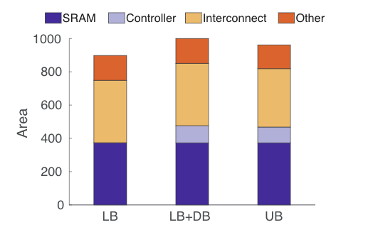
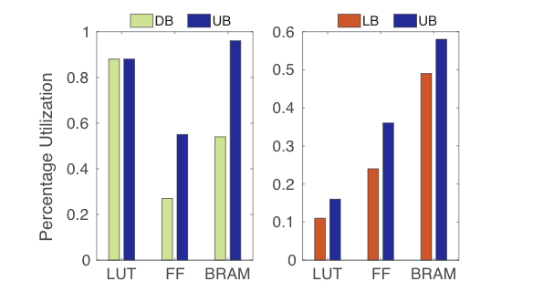
Unified Buffer Overhead
CGRA Memory Tile Area Breakdown
FPGA Memory Resource Breakdown
LB apps: 3x3 convolution
DB apps: U-Net convolution layer feature map buffer
Notes:
Our unified buffer did not have much resource, on both CGRA(ASIC) and FPGA

Slide 27
Conclusion
Unified buffers are a new push memory abstraction which can cover a wide range of image processing and deep neural network applications.
Keeping the behavior of data streams allowed us to optimized the memory, reducing both capacity and bandwidth requirements.
We created a hardware acceleration generator from Halide, a high-level language.
Notes:
Using unified buffer abstraction also make it possible to create broad range hardware acceleration generator and introduce possible extension in new application areas.

Slide 28
Thanks
Q&A

Slide 29
Mapping to Global Buffer
Global Buffer has limited functionality compared to Unified Buffer
No ability to execute loop nests natively
Accesses must be linear (with some valid/invalid period)
Can queue up multiple linear accesses
Use the M3 to carefully queue up accesses to mimic Unified Buffer
M3 decomposes loop nest and issues next inner-loop as previous one completes
Global Buffer configured to execute queued pattern once current input is exhausted
Interrupts back to M3 each time an input completes
Future Goals
Make the Global Buffer a full Unified Buffer
Have CGRA I/O backpressure Global Buffer
Notes:
For mapping to the global buffer, the main thing to keep in mind is that the inner loop of the unified buffer parameters is always going to be some sort of linear access (stride 1).
Since there's no backpressure coming from the CGRA, we also need some way of specifying if the data needs to be active for 16 cycles and inactive for 240 etc. to synchronize with other input streams.
After this point we can compute the loop nest on the M3, and issue the innermost linear segments sequentially on the CGRA.
Address does not increment during invalid period.

